Slide 1
The American Colonies Take Shape (1607-1765)
Chapter 3

Slide 2
Immigration and Slavery
Section 1

Slide 3
Migration
80 - 90% of England’s colonies were filled with English immigrants
Most were indentured servants
Worked 4-7 years in exchange for passage to the New World

Slide 4
Immigration
Many Irish from IRELAND immigrate
Over 250k Irish move to America
Came to look for a new beginning
Move westward to PA in order to farm

Slide 5
Germans
100k: Most were Protestant
War, taxes and religion forced many to come here (Push factors)
William Penn recruited many Germans to his territory

Slide 6
Slave Trade
1 in 5 colonists (20%) are African slaves
Triangular trade is 3 way trade b/w Africa, America and Europe
37% taken to Brazil / 41% Non-Spanish Caribbean
15% taken to Spanish America
4.5% taken to American Colonies

Slide 7
Middle Passage (Africa – New World)
6 – 8 week journey from Africa to New World
Slaves were shackled and packed into ships lowest levels
Each floor was 3ft 3in high
Between 10 and 40% of slaves would die on the way due to: lack of sanitation, air, and SUICIDE

Slide 8
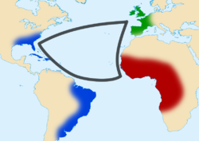

Slide 9
Slavery in Southern Colonies
South Carolina
Georgia
Over 50% of population
Excelled in growing rice b/c they did that in their homeland
Experienced WORSE physical conditions of all slaves
Over 33% of population
Separated from their families so other slaves would step into family roles

Slide 10
New England / Middle Colonies
Only about 5k total : 1/8 of what was in the Southern colonies
More freedom to choose what to do / families kept together
Worked as skilled laborers: Lumberjacks, artisans, shipbuilding, fishermen, whalers, and cooks

Slide 11
Free Africans
Not FREE until after the American Revolution (only in the North)
Usually did the same job as slaves but lived in worse economic conditions (less food / worse shelter ) bc they had to buy their own now
Could not vote or marry white Americans

Slide 12
Laws / Revolts
Changed from colony to colony
Slaves generally could not leave town without a pass
Also needed a pass to board any ship
Stono Rebellion

Slide 13
Section 1 Review:
1. Why did most German immigrants come to America?
2. Where did the MOST of the African Slaves get taken to?
3. Describe the MIDDLE PASSAGE.
4. What were 3 of the jobs a slave could do in NEW ENGLAND?

Slide 14
The American Colonies and England
Section 2

Slide 15

Magna Carta (1215)
Limited power of the King
Set limitations on TAXES the King could set / must ask nobles
Gave right to trial (not always fair)
Quick or speedy justice

Slide 16
Bill of Rights (1689)
Habeas Corpus: Can’t be held (in jail) w/o being charged w/ a crime
No army in times of peace (lowered taxes)
King could not limit free speech
Right to bear arms / no cruel or unusual punishment

Slide 17
Consumer Revolution
Colonists were SELF SUFFICIENT (survived w/o others help)
With the new TRANSATLANCTIC trade they could buy goods from Europe
Survival was now possible from outside sources

Slide 18
Navigation Acts
Laws set to make England wealthy
1. Colonies must ship TOBACCO and SUGAR to ENGLAND only
2. Any goods arriving in colonies must be brought through an ENGLISH port for TAXATION
This ensured taxes were paid on all goods brought to the colonies

Slide 19
Triangular Trade
Raw materials (timber, tobacco) to from America to Europe
Manufactured goods (guns, chairs) from Europe to Africa
Enslaved Africans from Africa to America (Middle Passage)

Slide 21
New Ideas: Enlightenment
Scientific Revolution
Used Physics and Math to explain the world (scientific method)
People like Isaac Newton and Ben Franklin
Leads to inventions: Lightning rod, bifocal glasses

Slide 22
Great Awakening
Religious movement in the 13 American Colonies
Opposite of Enlightenment
Claimed God was responsible for everything and the Earth’s creation
Many African slaves find it appealing and convert to Christianity for the 1st time

Slide 23
Section 2 Review:
1. List 2 parts of the MAGNA CARTA.
2. What does “Habeas Corpus” mean?
3. Through the NAVIGATION ACTS what 2 crops must be traded to England only?
4. Compare the ENGLIGHTENMENT to the GREAT AWAKENING.

Slide 24
Comparing Regional Cultures
Section 3

Slide 25

New England
Cold climate = Little farming
Fish / timber were major EXPORTS
Boston was biggest trading port
Generally wealthier people came here

Slide 26
Middle Colonies
Temperate climate / some farming
WHEAT was major export
Philly and NY were biggest cities (25k)
Mostly English immigrants

Slide 27

The South
Warmest climate = Mostly farming
Produced most valuable crops; rice, indigo, TOBACCO
Most profitable area to live / did NOT pay workers
Used slaves to cultivate (grow) crops

Slide 28
Women
Women were PROPTERY of men
Could not :
Vote
Own land
Hold office
Jobs included:
Cook / clean
Sew / laundry
Garden
Child care

Slide 29
Education
New Englanders learned to read by reading the BIBLE daily
Usually children were home schooled
Wealthy could hire a tutor
Harvard 1st Colonial University (150 students)

Slide 30
Public School
1 Room school house; walked from miles around
All grades in same room
Subjects were: Reading, writing and arithmetic
Teachers were mostly female
Rules were VERY STRICT

Slide 31
Punishment
Fine and EXPULSION for the following offenses:
Fighting
Bad language
Lying
Challenging authority
Laziness

Slide 32
Section 3 Review:
1. What was the major export of New England? Why?
2. What was the climate of the Middle Colonies?
3. Which area produced the most VALUABLE crops?
4. Describe the role of women, in the past.

Slide 33
The French and Indian War
Section 4

Slide 34

French / Indian War
1754 – 1763
Known as the 7 years war in Europe
Fought between France (and Indians) versus England and their territories in America

Slide 35
Causes of War
Rivalry (competition) between Britain and France
French settlements were inland (Mid West), built FORTS
English settlements were along the coast and they cleared land for agriculture and built TOWNS

Slide 36
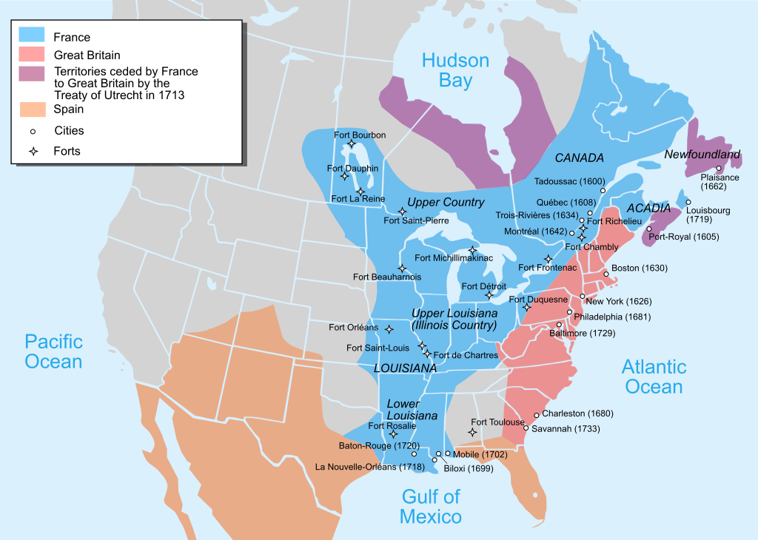

Slide 37
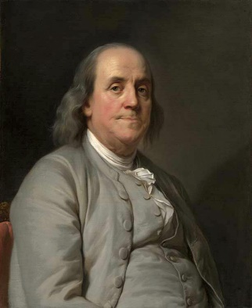
Benjamin Franklin
Pennsylvania; Creates ALBANY PLAN of UNION
Its purpose was for a unified (ALL COLONIES) war effort against the French
All Colonies to essentially fight together
1st Postmaster of PA

Slide 38
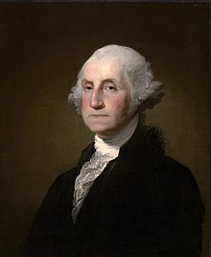
George Washington
From Virginia Colony
English Colonial commander
Shot 4x but survives
Loses 1st battle

Slide 39
Fort Necessity
900 French vs. almost 2,000 British
3 hour battle, 1/3 of British troops killed
British fought in straight lines
French used mobile warfare

Slide 40
England Wins!
British Prime Minister borrows huge sums of money to fight the war
British troops better prepared and defeat the French in Western PA
British would take Fort Duquesne and Fort Niagara

Slide 41

Treaty of Paris 1763
Officially ends the French Indian War in America
Canada and all lands east of the Mississippi river except New Orleans annexed (taken) by England
England trades Cuba for Florida

Slide 42
Section 4 Review:
1. Who fought in the French Indian War? Who won?
2. What did BEN FRANKLIN create?
3. Which commander was shot 4x?
4. Describe the battle at Fort Necessity.

